Slide 1
Urban Mobility Experimental Campaign
Pranav Pandya
Supervisors: Prof. Maider Llaguno-Munitxa, Prof. Martin Edwards
Louvain research institute for Landscape, Architecture, Built environment (LAB)
Architecture et Climat Research Group
Catholique University of Louvain (UCLouvain)

Slide 2
Contents of Presentation
Planning for experiment
  Number of Participants
  Time & duration of experiment
  Location of Experiment
  Survey
  Checklist
  Data
  Qualitative Results of Experiment

Slide 3
Motivation & Research Gap
The Problem
This Study
Most outdoor comfort studies focus on stationary subjects
Dynamic multi-sensory exposures during commuting are poorly understood
Thermal acclimatization outdoors (green → urban → tram) is unquantified
Physiological & psychological stress responses rarely measured simultaneously
Mobile participants across 3 environments: Green · Urban · Tram
3 mobility modes: Walking · Biking · Seated (tram)
Simultaneous wearable physiological + subjective psychological measurements
Controlled afternoon timing to capture peak thermal stress (UTCI/PET)
Pranav Pandya · UCLouvain · Urban Mobility Experimental Campaign

Slide 4
No. of Participants
Sample Size Calculation for the Experimental Campaign
Statistical Methodology
A priori power analyses align with the primary within-subject design:
Repeated-Measures ANOVA across mobility modes (walk, bike, tram), each performed in afternoon.
Key Statistical Parameters
Significance level (α): 0.1
Target power (1 – β): 0.80
Within-subject conditions: 5 (walk-green, bike-green, tram, walk-urban, bike-urban)
Effect-size grid (expecting medium to large effect size):
  Paired t: Cohen’s d = 0.50 (Medium), 0.80 (Large)
Cohen’s f notation (medium = 0.25, large = 0.40)
Dropout cushion: +5% recruitment
Working Hypotheses
Participants will show improved physiological and psychological well-being in green vs. impervious areas.
Acclimatization takes longer after green and air-conditioned settings due to greater heat stress contrasts.
Physiological and psychological responses will align.
Noise & activity will amplify thermal discomfort.
Analysis Method | Effect Size Category | Effect Size Value | Required N | Notes
Repeated-Measures ANOVA | Medium | f = 0.25 | 17 participants | Can detect medium differences across several repeated conditions per participant (Hypothesis 2 & 4: interaction of mobility mode and environment type — walking, biking × green, impervious).
Repeated-Measures ANOVA | Large | f = 0.4 | 8 participants | Can detect large differences across several repeated conditions per participant (Hypothesis 2 & 4: interaction of mobility mode and environment type — walking, biking × green, impervious).

Slide 5
Experimental Timeline

Slide 6
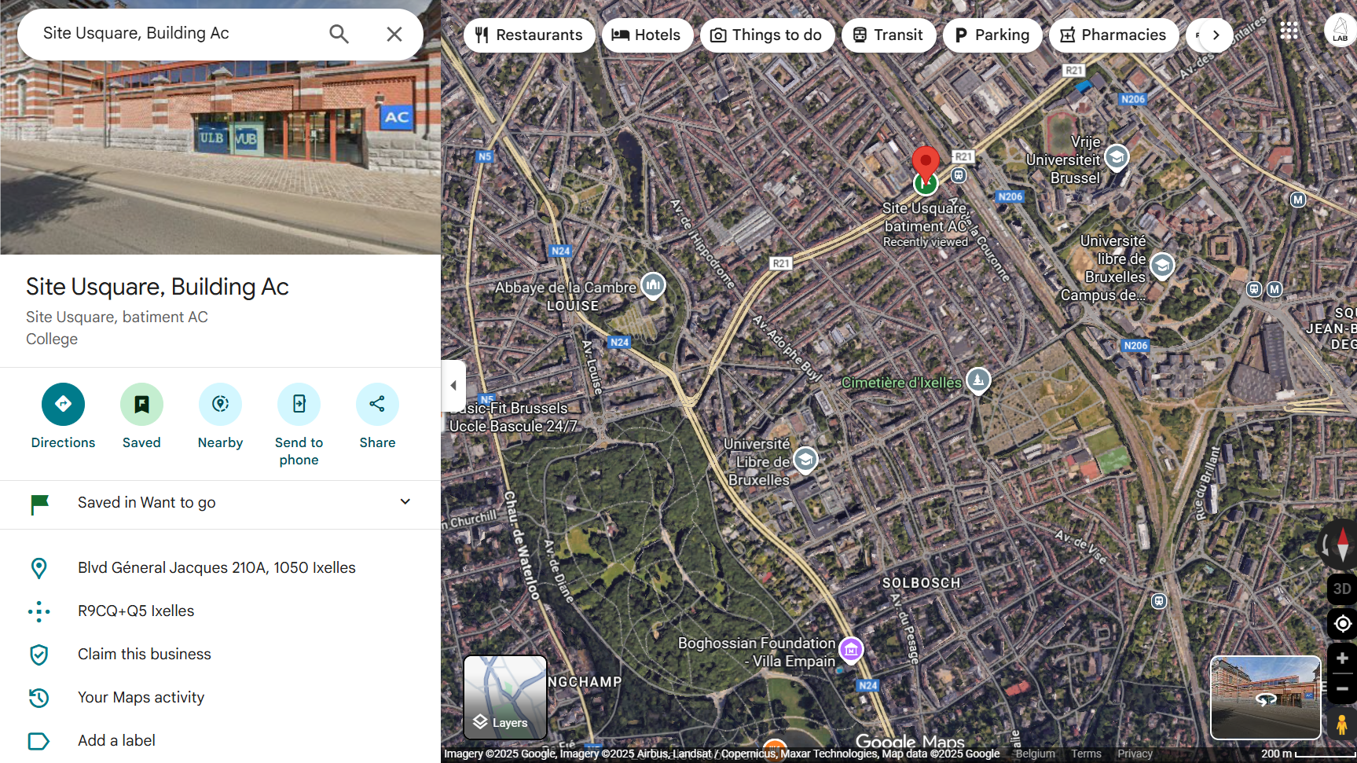
Location Plan
Environments covered = Green space + Urban + Tram

Slide 7
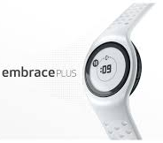
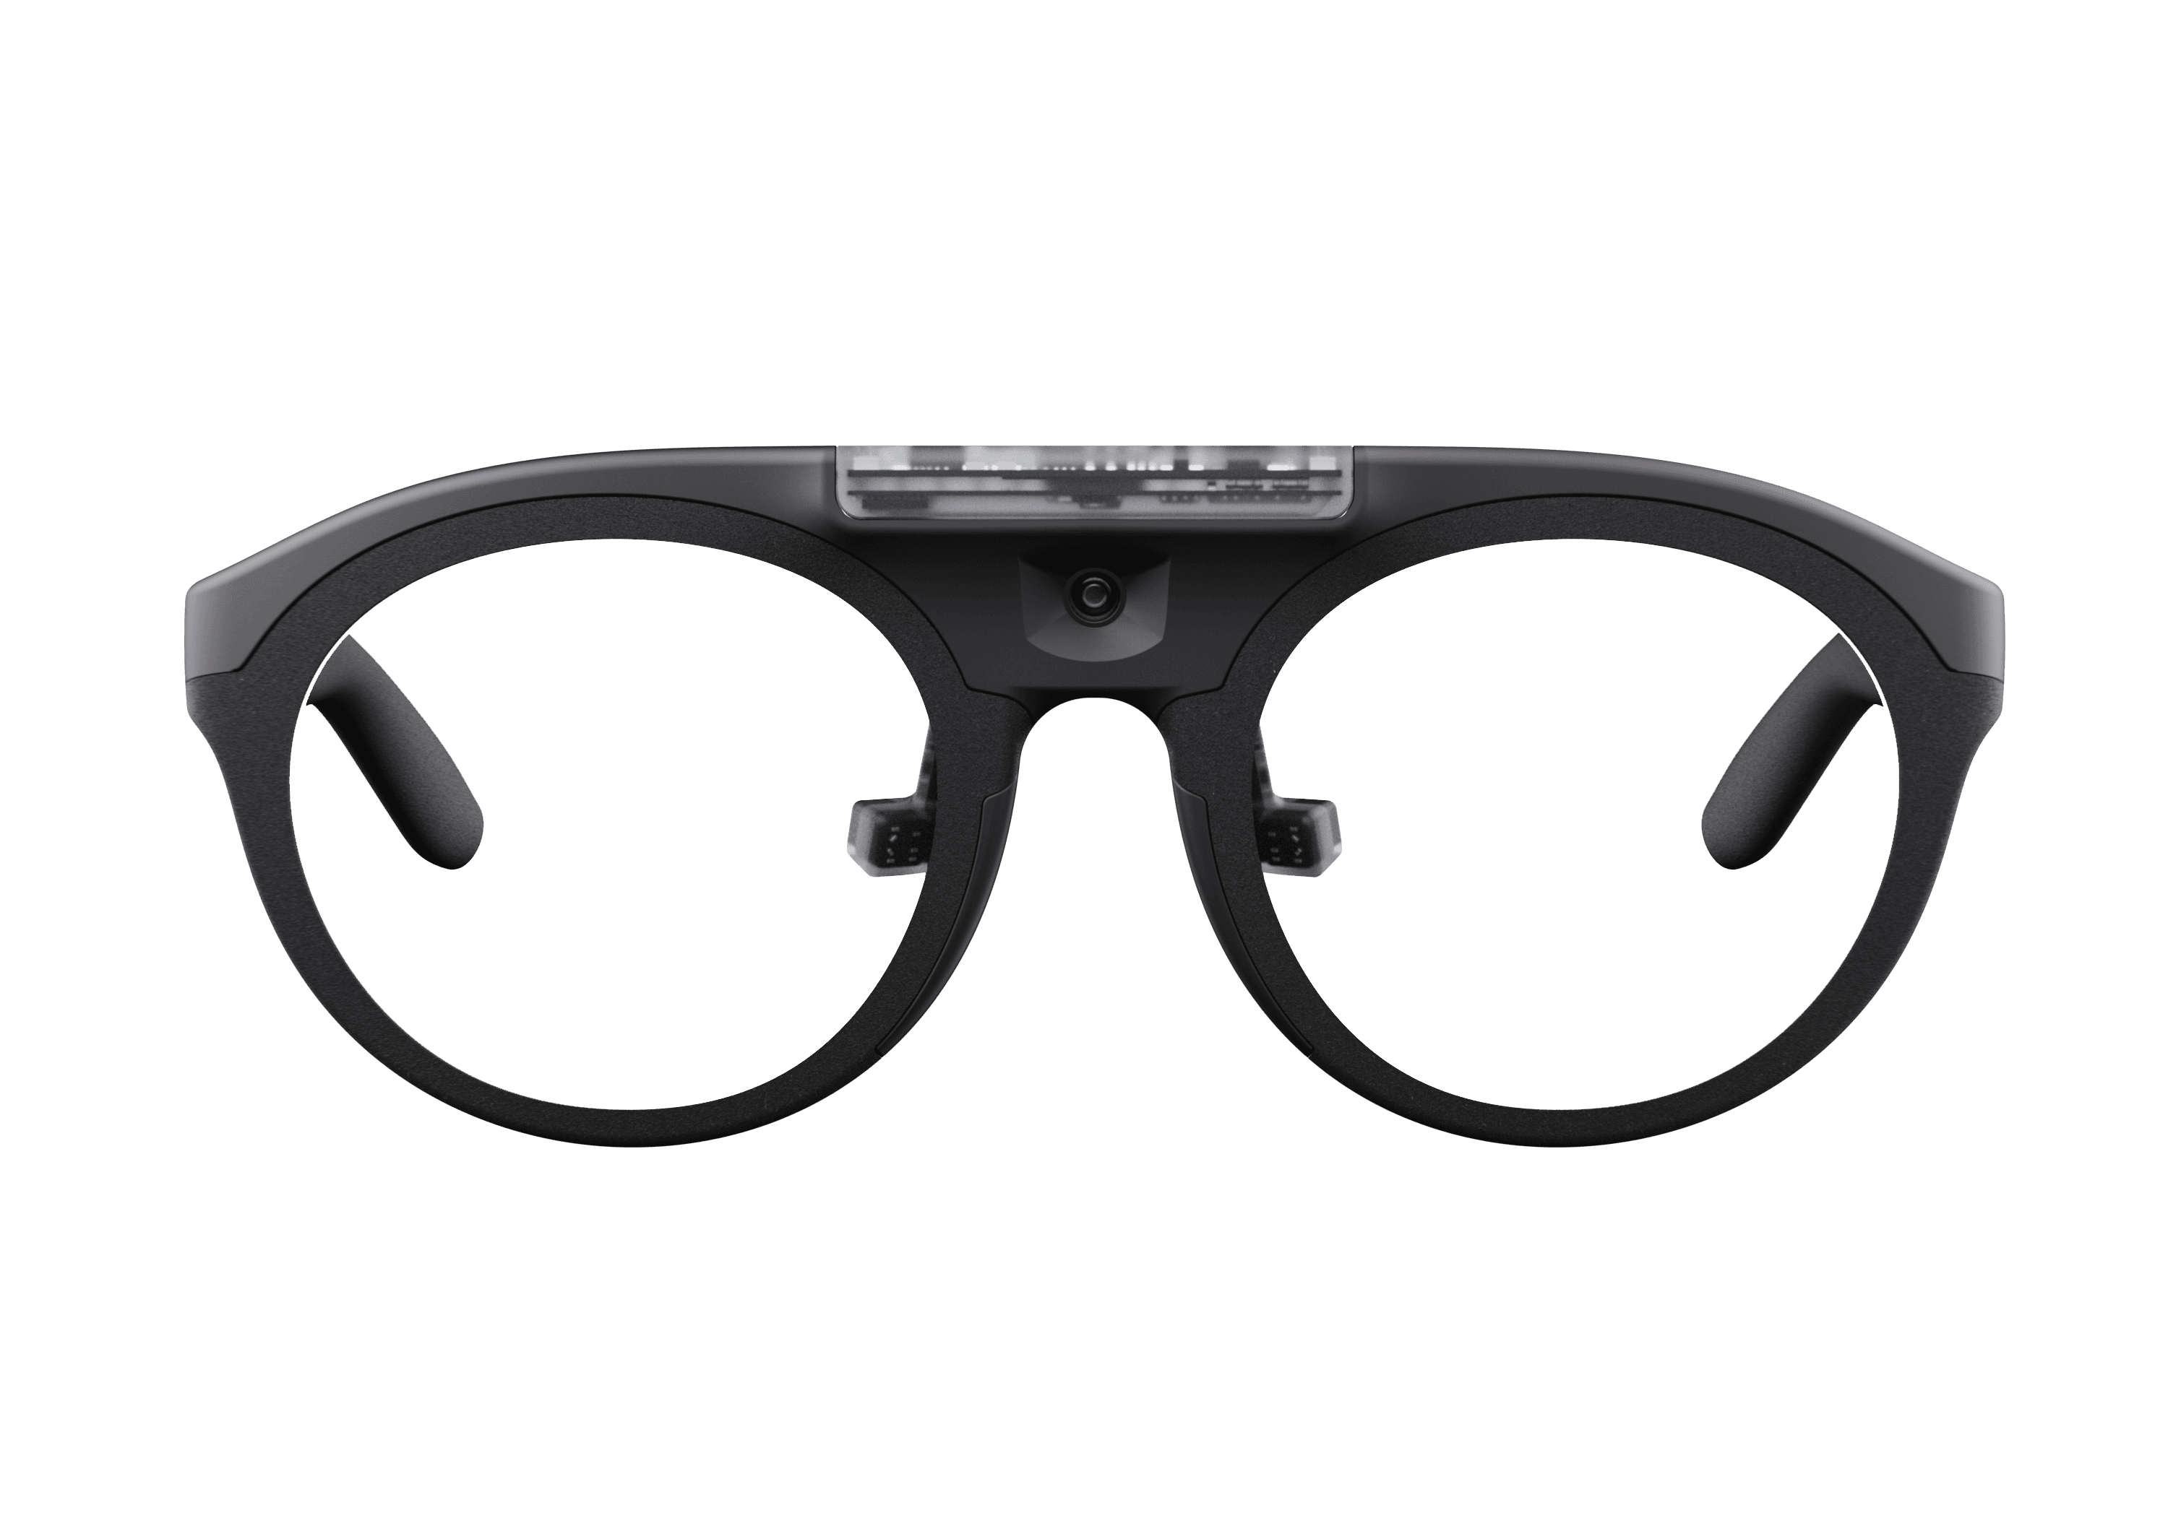
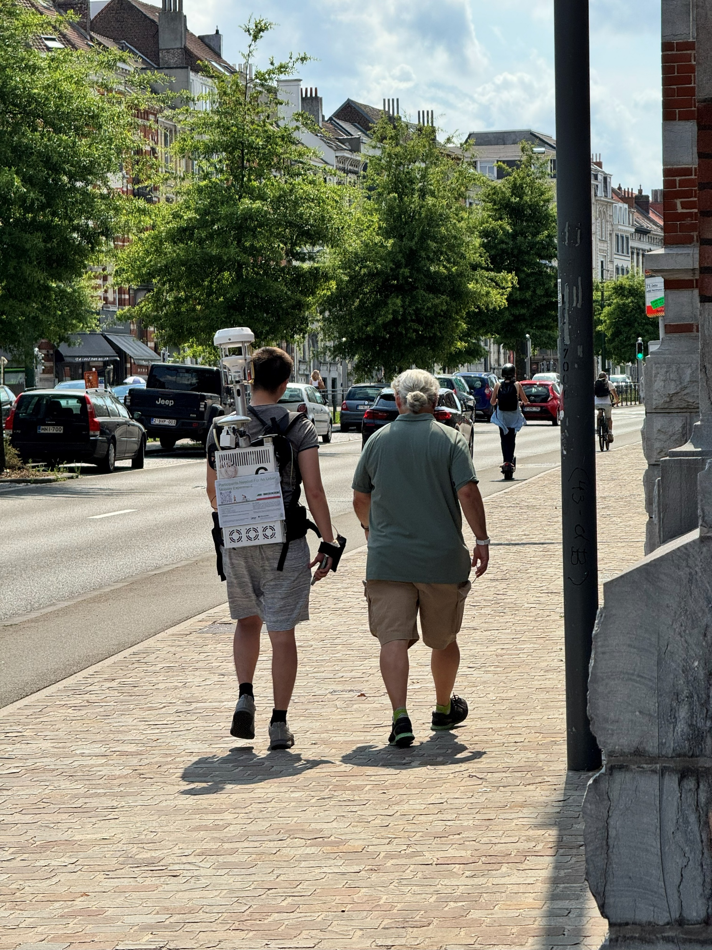
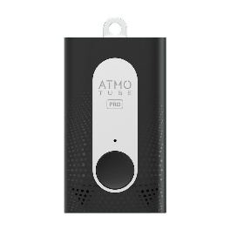
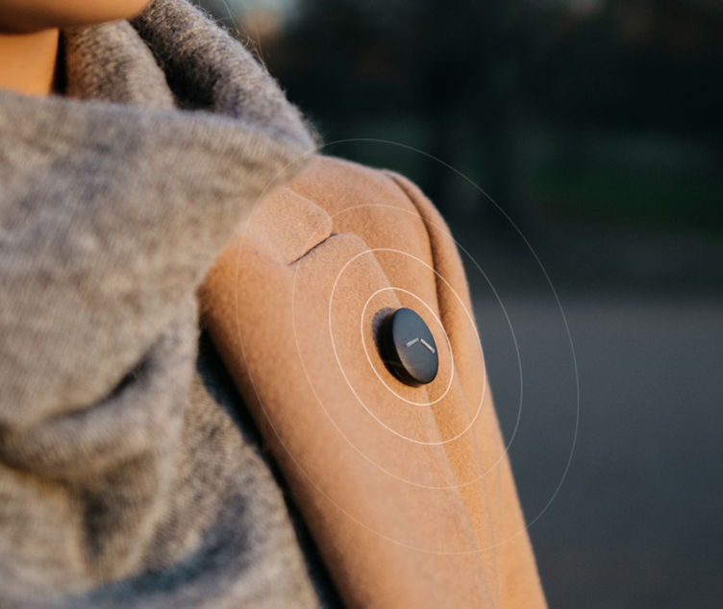
Sensors
Sensors used in the experiment
Empatica Embrace Plus (Smart Watch) | Pupil Labs Neon smart glasses (eye-tracking)
Atmotube PRO measuring air pollution | LYS Button (measuring illuminance)
uCM backpack

Slide 8
Sensors
Sensors used in the experiment
(A)
(B)
(C)
(D)
(E)

Slide 9
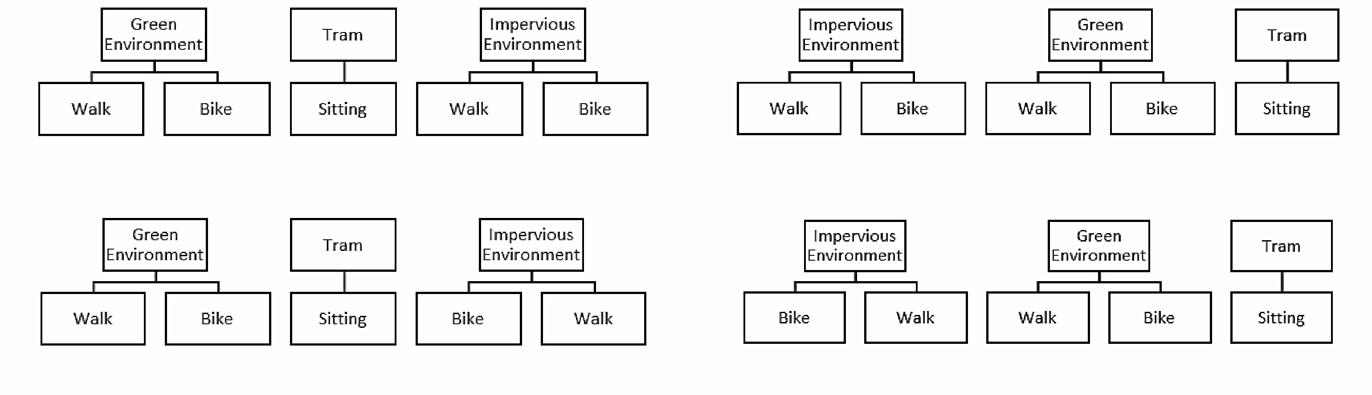
Location Plan
Route Map 1-2
Route Map 3-4

Slide 10
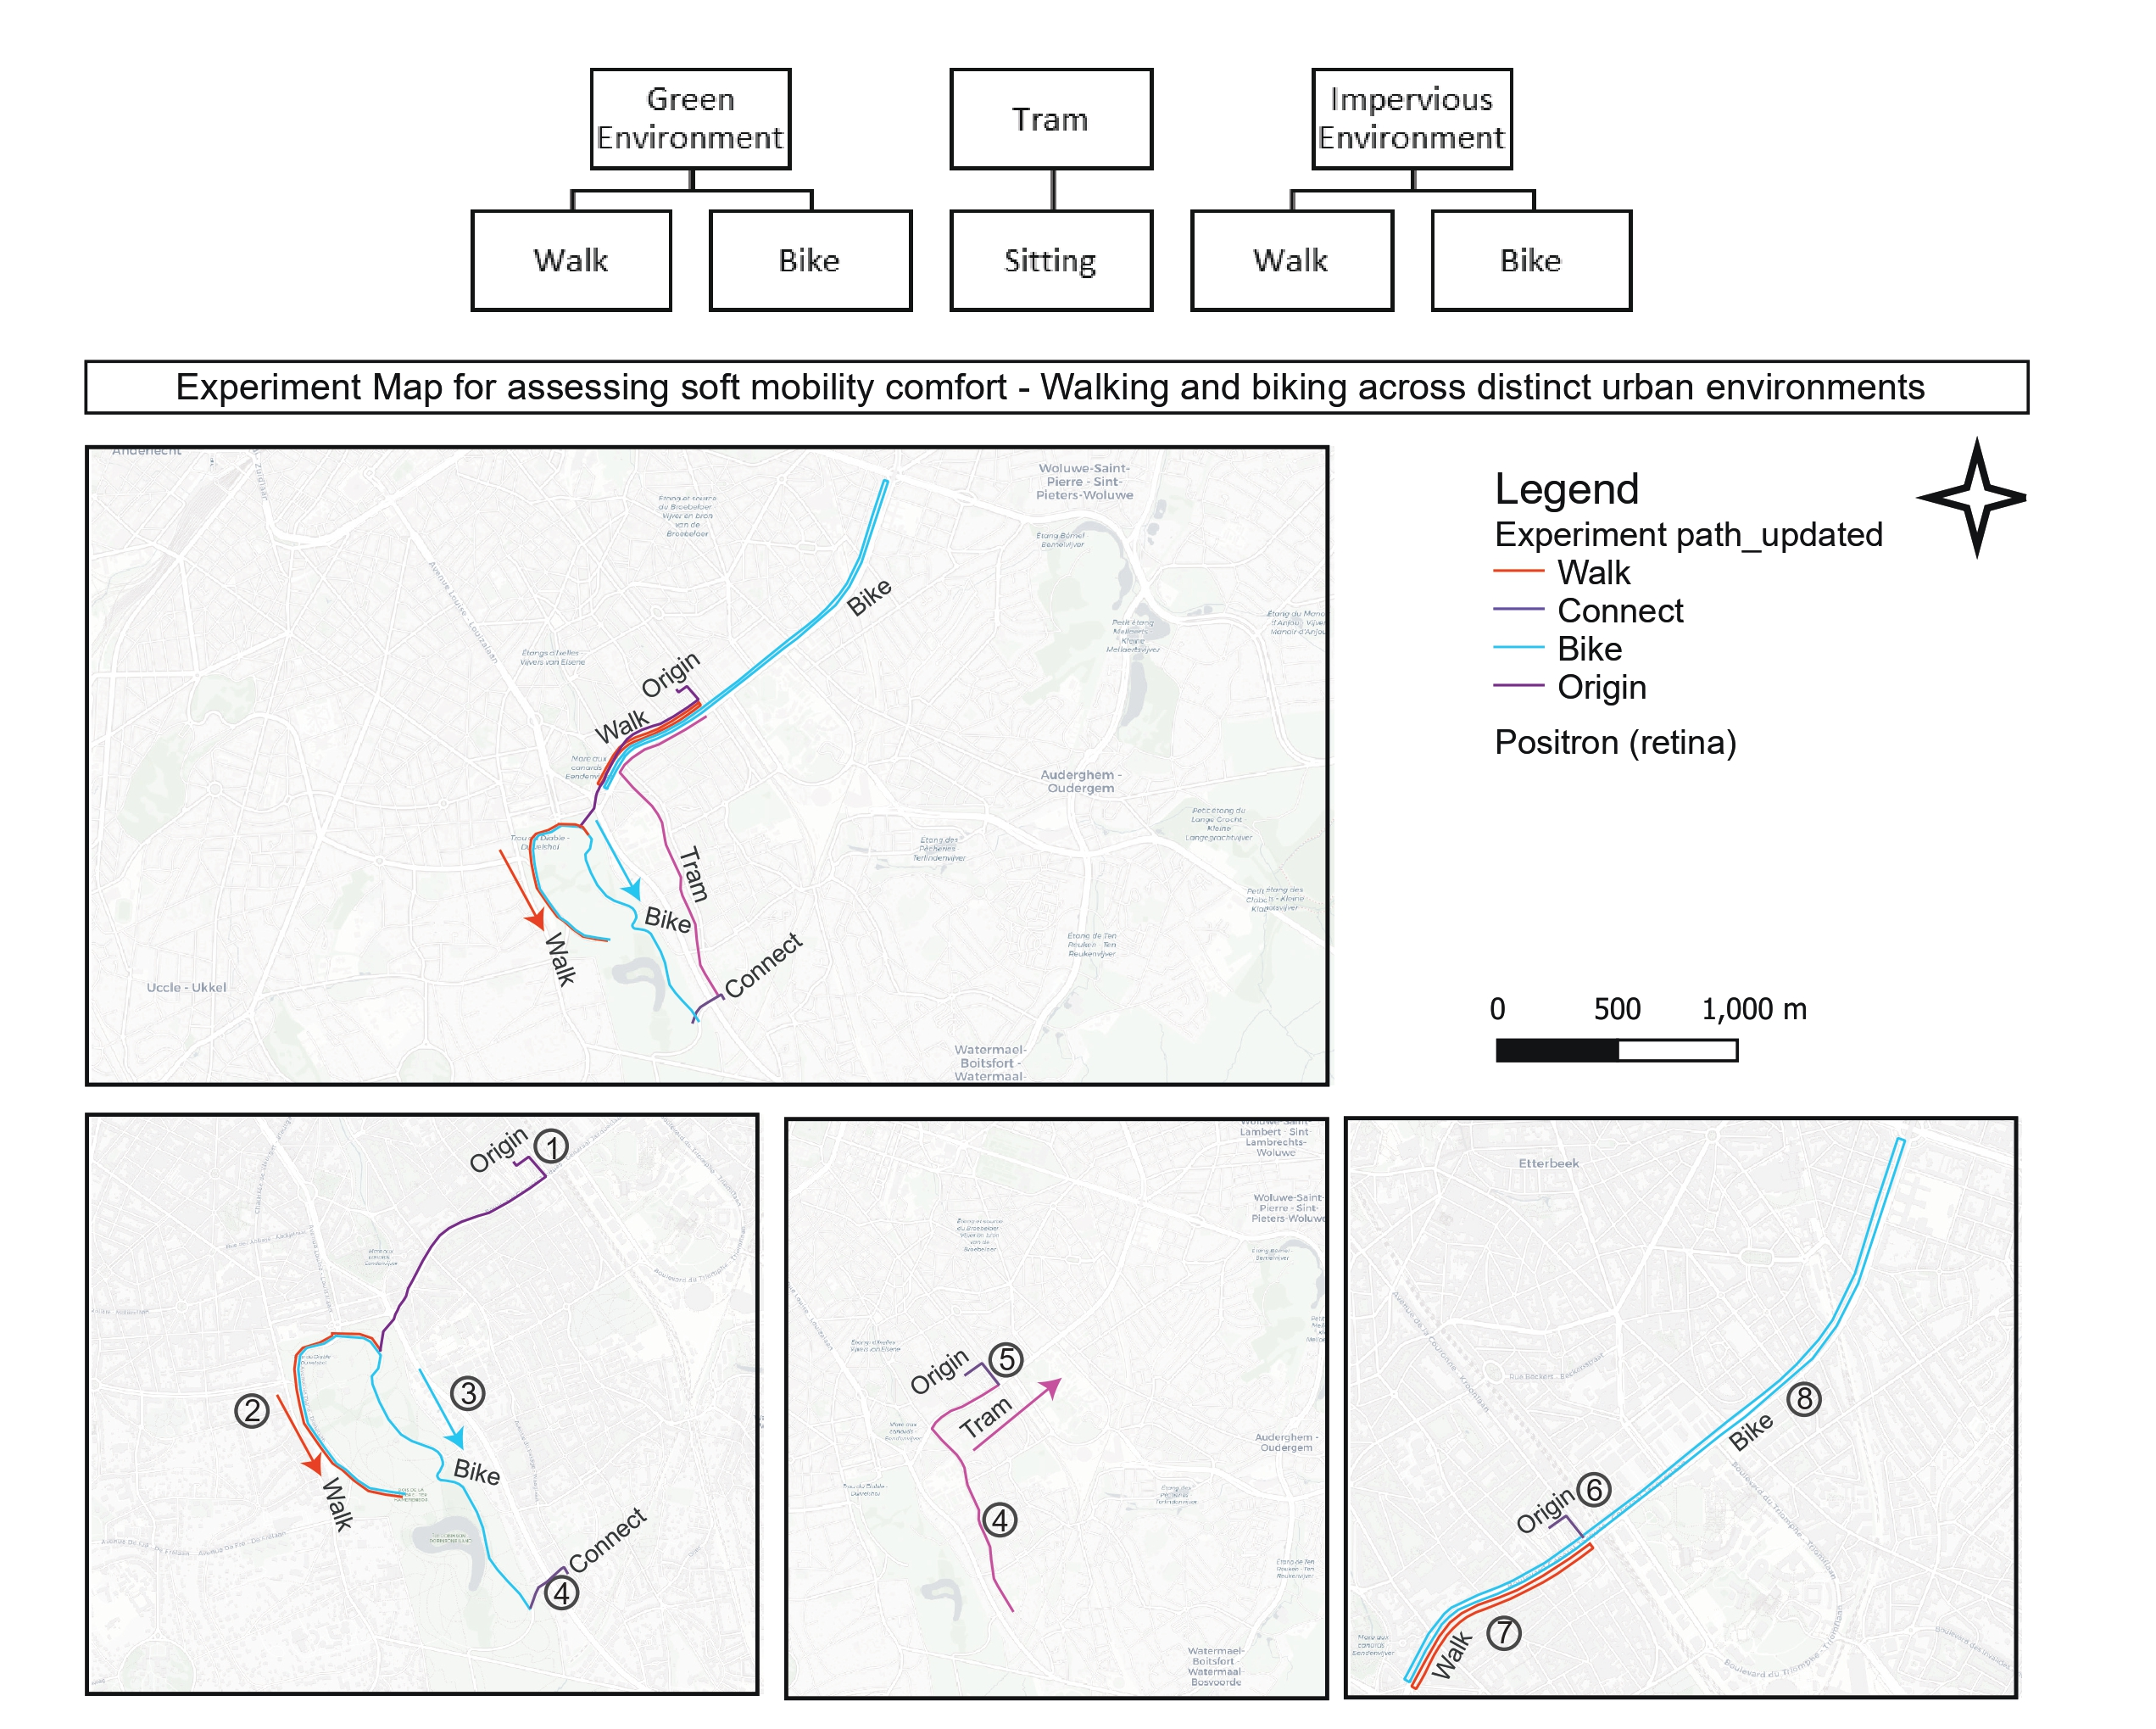
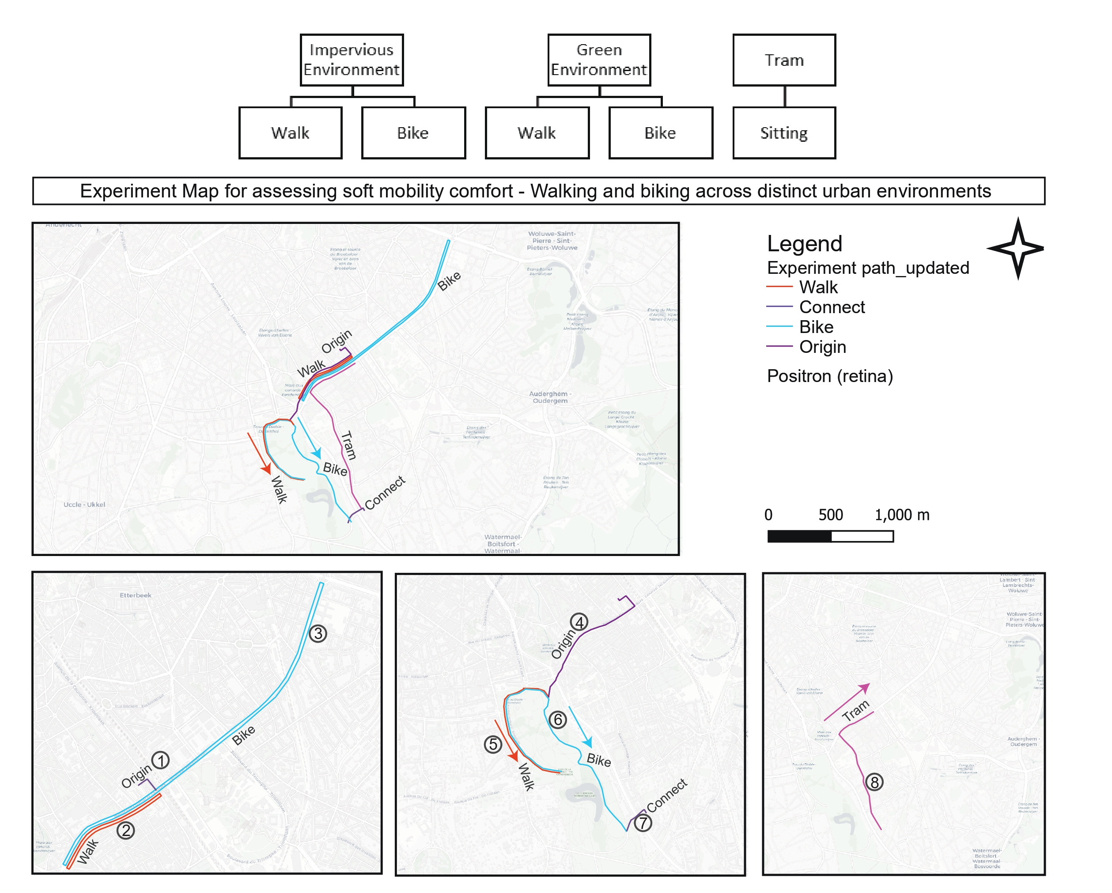
Location Plan
Route Map 1-2

Slide 11
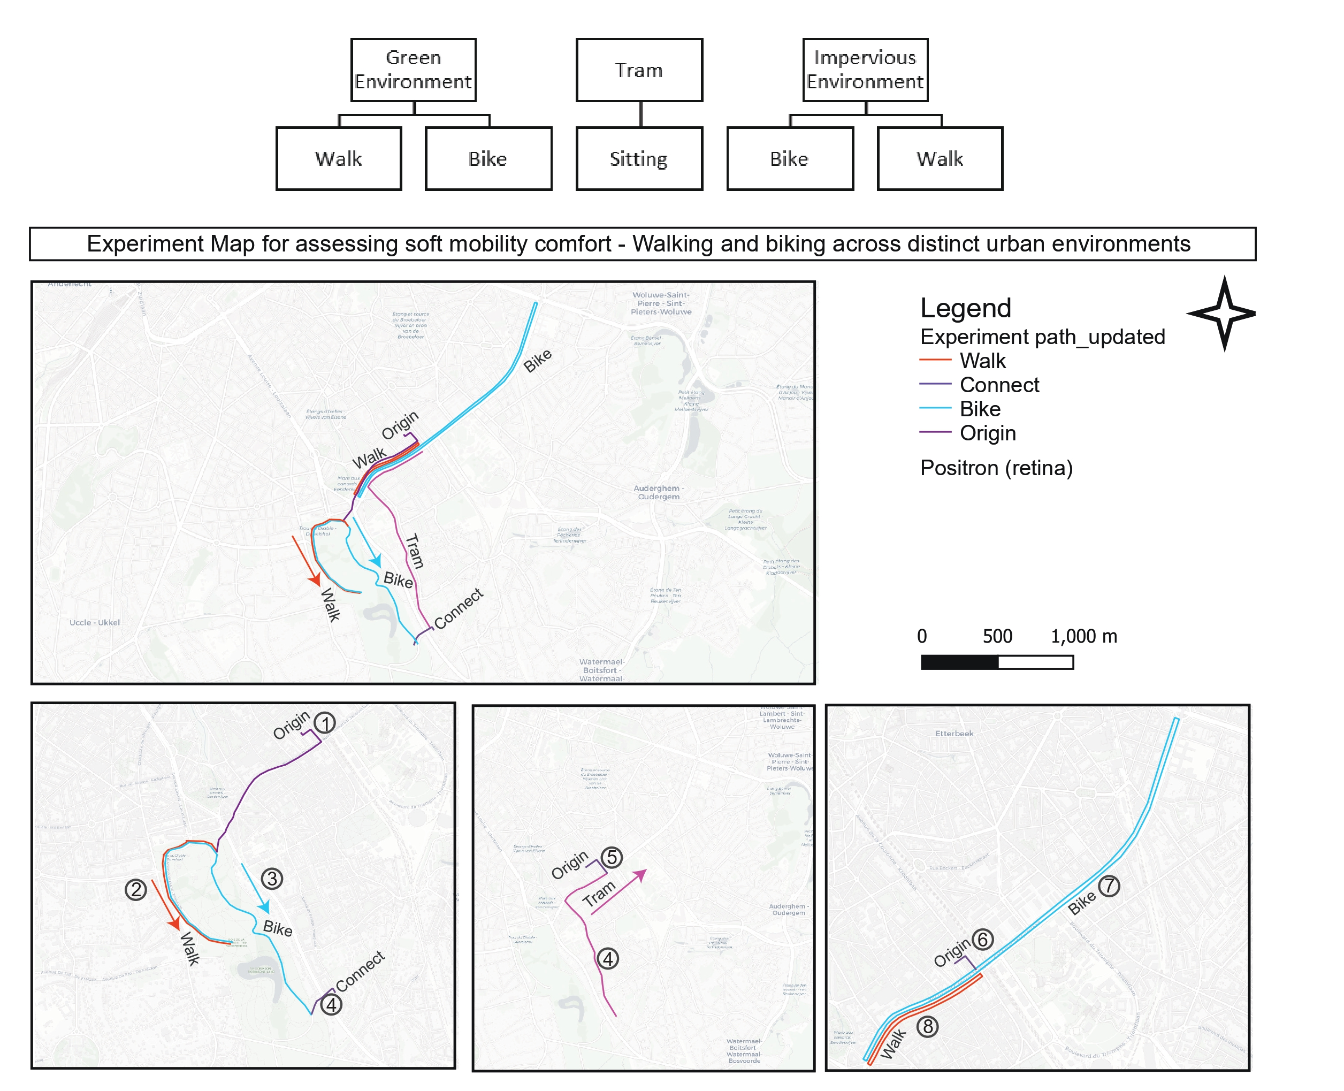
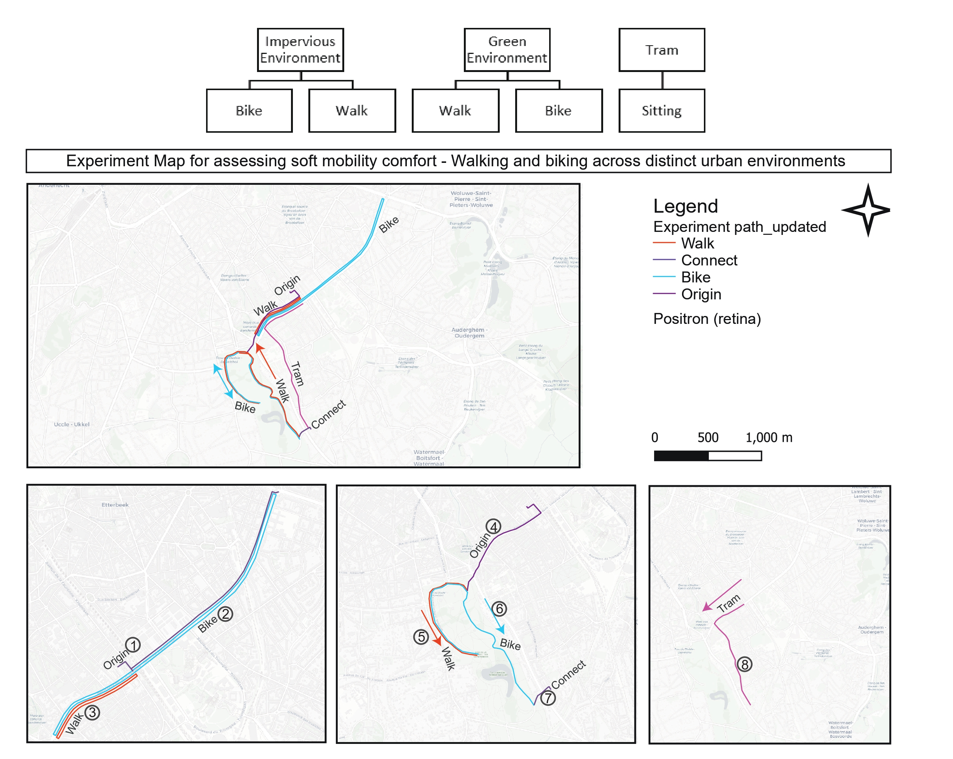
Location Plan
Route Map 3-4

Slide 12
Survey
Participant Background Survey
Category | Questions | Response Type
Identity | What is your name? | Text field
Demographics | What is your age? | Text field
 | What is your gender? | Multiple choice: Male/ Female/ Prefer not to say
 | What is your nationality or country of origin? | Text field
Residence | Where do you live in Brussels? | Text field
 | How long have you been living in Brussels? | Text field
Physical Characteristics | What is your laterality? (Are you left or right-handed?) | Binary choice: Left / Right
 | What is your current body weight? In Kg. | Text field
 | What is your height? In cm. | Text field
 | What are you currently wearing? Please describe your outfit as precisely as possible with colour (e.g., short-sleeved shirt, jeans, sandals, light jacket, etc.). | Text field
 | What do you normally use for vision correction? | Normal vision/ Wear glasses/ Wear contact lens / Uncorrected vision impairment/ Prefer not to say
Familiarity | How well do you know the streets and surroundings where the experiment is in Brussels? | Linear scale 1–10: Not at all familiar (1) / Extremely familiar (10)
Living Environment | What is your type of residence? | Binary choice: City / Suburban environment
Household | Do you have children? | Multiple choice: Yes / No
Mobility | How do you commute to work? | Multiple choice: Walk/ Bike/ Train/ Metro/ Tram
Physical Activity | Is there any sport or physical activity you practice regularly? Name it. Else write no. | Text field
 | How frequently do you bike? | Daily/ Few times week/ Few times month/ Rarely/ Never
 | On average how much do you walk every day? | <15 min/ 15 to 30 min/ 30 min to 1 hr/ 1 to 2 hr/ > 2 hr

Slide 13
Survey
Psychological Surveys (Recurring – 6 times per participant)
Item | Question | Response Format | Source Framework
1 | How comfortable do you feel right now? | Very uncomfortable / Uncomfortable / Slightly uncomfortable / Neutral / Slightly comfortable / Comfortable / Very comfortable | Comfort Sensation Vote
2 | Please describe your thermal sensation | Cold / Cool / Slightly cool / Neutral / Slightly warm / Warm / Hot | Thermal Sensation Vote
3 | Which environmental factor is most affecting you right now? | □ Temperature □ Lighting □ Noise □ Air Quality □ Crowding | Environmental Stressor
4 | I feel calm | Not at all / A little / Moderately / Quite a lot / Extremely | STAI
5 | I feel tense | Not at all / A little / Moderately / Quite a lot / Extremely | STAI
6 | I feel upset | Not at all / A little / Moderately / Quite a lot / Extremely | STAI
7 | I feel relaxed | Not at all / A little / Moderately / Quite a lot / Extremely | STAI
8 | I feel content | Not at all / A little / Moderately / Quite a lot / Extremely | STAI
9 | I feel worried | Not at all / A little / Moderately / Quite a lot / Extremely | STAI
10 | Places like that are fascinating | Not at all / A little / Moderately / Quite a lot / Extremely | PRS
11 | In places like this my attention is drawn to many interesting things | Not at all / A little / Moderately / Quite a lot / Extremely | PRS
12 | In places like this it is hard to be bored | Not at all / A little / Moderately / Quite a lot / Extremely | PRS
13 | Places like that are a refuge from nuisances | Not at all / A little / Moderately / Quite a lot / Extremely | PRS
14 | To get away from things that usually demand my attention I like to go to places like this | Not at all / A little / Moderately / Quite a lot / Extremely | PRS
15 | To stop thinking about the things that I must get done I like to go to places like this | Not at all / A little / Moderately / Quite a lot / Extremely | PRS
16 | There is a clear order in the physical arrangement of places like this | Not at all / A little / Moderately / Quite a lot / Extremely | PRS
17 | In places like this it is easy to see how things are organised | Not at all / A little / Moderately / Quite a lot / Extremely | PRS

Slide 14
Survey
Psychological Surveys (Recurring – 6 times per participant)
Item | Question | Response Format | Source Framework
18 | In places like this everything seems to have its proper place | Not at all / A little / Moderately / Quite a lot / Extremely | PRS
19 | That place is large enough to allow exploration in many directions | Not at all / A little / Moderately / Quite a lot / Extremely | PRS
20 | In places like that there are few boundaries to limit my possibility for moving about | Not at all / A little / Moderately / Quite a lot / Extremely | PRS
21 | How pleasant do you feel in this place? | Not at all / A little / Moderately / Quite a lot / Extremely | Greenness

Slide 15
Data Streams & Processing Pipeline
uCM Backpack
Eyetracker
(Pupil Labs)
Empatica
Embrace+
LYS Button
Atmotube PRO
Δt = 1 sec
Δt = 1 sec
Δt = 1 min
Δt = 30 sec
Δt = 1 min
Tmrt · UTCI · PET
Temp · RH · Wind · Sound · GPS
Gaze fixation
Saccades · Blinks
EDA · PPG
Skin temperature
Illuminance
(melanopic lux)
PM1 · PM2.5 · PM10
VOC · CO₂ · AQI
Merged at 1-minute resolution → Combined per-participant dataset

Slide 16
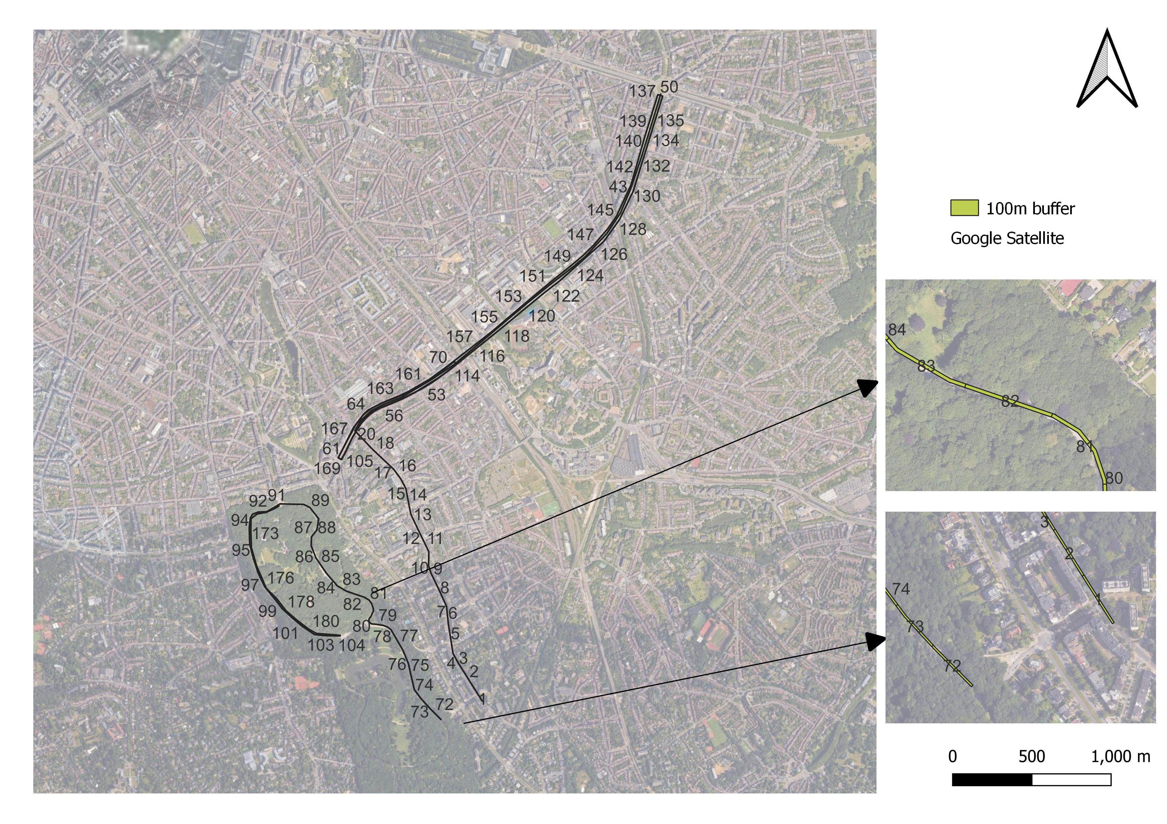
100m buffer
Temporal contrasts: Clear Sky conditions across experiment. Measured with Clearness Index (CI)
Image Segmentation: Google Street View images were retrieved for each of the 100m buffers in months – April to October (summer) and process using Xception deep learning image segmentation model

Slide 17
Average Speed – buffer diameter for GVI
Phase | Avg Speed (m/s) | Avg Speed (km/h) | Median (km/h) | Std Dev (m/s)
WalkG | 1.115 | 4.02 | 4.27 | 0.261
WalkU | 1.108 | 3.99 | 4.01 | 0.178
BikeG | 2.546 | 9.17 | 9.52 | 0.409
BikeU | 2.821 | 10.15 | 10.88 | 0.856
Tram | 4.334 | 15.60 | 15.26 | 0.613
Phase | Avg Speed | Distance in 15s
WalkG | 4.02 km/h | 16.7 m
WalkU | 3.99 km/h | 16.6 m
BikeG | 9.17 km/h | 38.2 m
BikeU | 10.15 km/h | 42.3 m
Tram | 15.60 km/h | 65.0 m

Slide 18
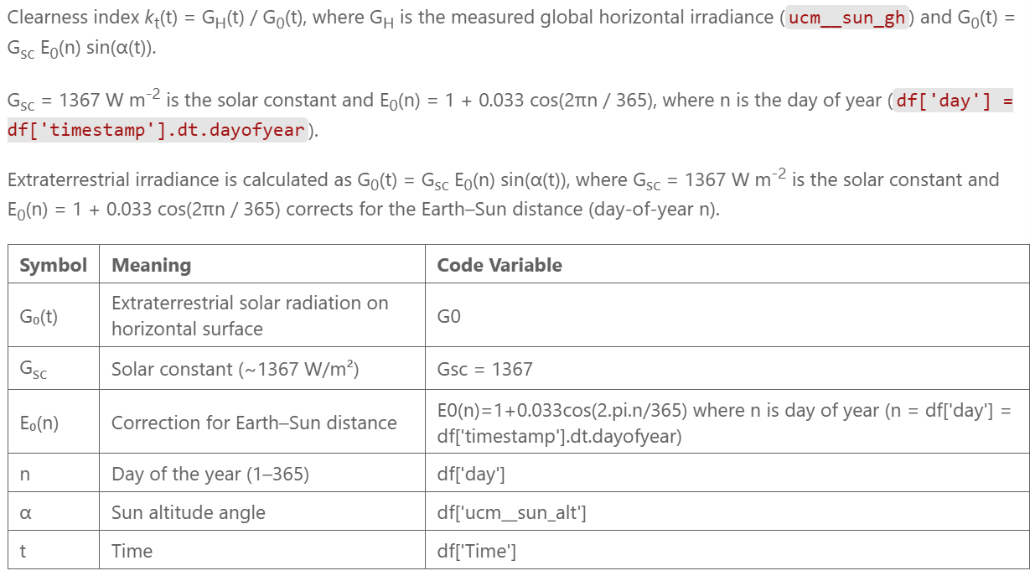
Results - Clearness Index
Source: https://www.sciencedirect.com/science/article/pii/S096014811630739X?via%3Dihub

Slide 19
Results – Clearness Index
ParticipantID | Clearness_Index_Max | Clearness_Index_Min | % Cloudy | % Partly Cloudy | % Sunny
2.0 | 0.893872 | 0.001376 | 55.93 | 5.65 | 0.56
3.0 | 0.824087 | 0.002395 | 48.33 | 20.83 | 20.83
4.0 | 0.966845 | 0.003458 | 49.61 | 20.47 | 18.11
5.0 | 0.893409 | 0.000020 | 56.82 | 9.09 | 2.84
6.0 | 0.942995 | 0.000766 | 60.00 | 7.78 | 2.78
7.0 | 0.911999 | 0.000265 | 55.25 | 16.57 | 4.42
8.0 | 0.766740 | 0.000806 | 52.60 | 12.14 | 2.31
9.0 | 0.777137 | 0.000167 | 66.94 | 21.77 | 3.23
10.0 | 0.801642 | 0.000140 | 52.59 | 20.69 | 18.10
11.0 | 0.931986 | 0.000935 | 50.00 | 16.67 | 20.83
12.0 | 0.968541 | 0.002774 | 48.67 | 23.01 | 16.81
13.0 | 0.842042 | 0.000965 | 66.95 | 14.41 | 6.78
14.0 | 0.703674 | 0.003417 | 53.08 | 28.46 | 0.77
15.0 | 0.851030 | 0.000469 | 40.98 | 27.05 | 18.03
16.0 | 0.952444 | 0.000084 | 43.59 | 25.64 | 21.37
17.0 | 0.736053 | 0.000743 | 83.05 | 5.08 | 3.39
18.0 | 0.828185 | 0.000190 | 60.36 | 22.52 | 1.80

Slide 20
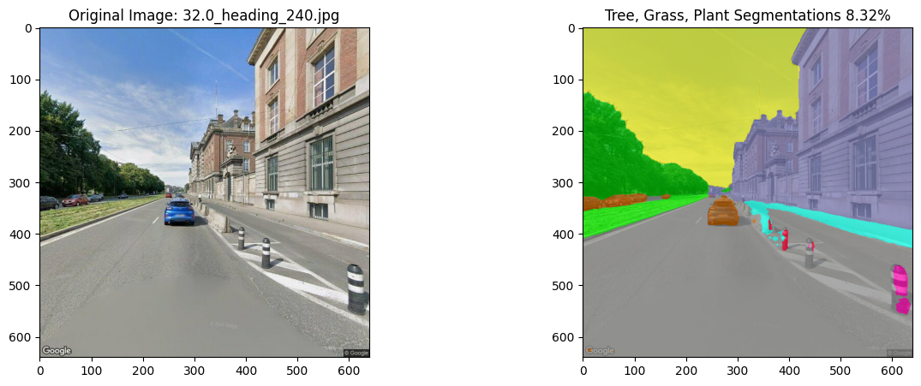
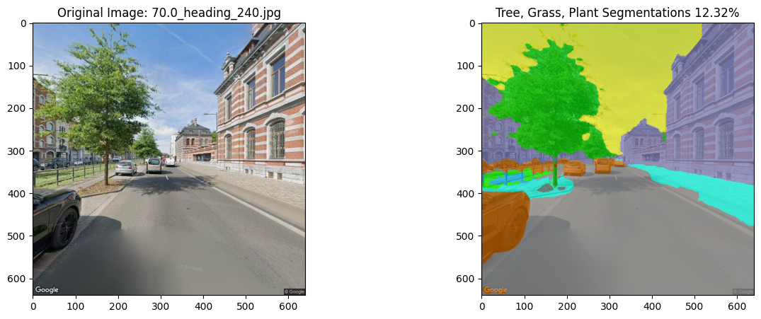
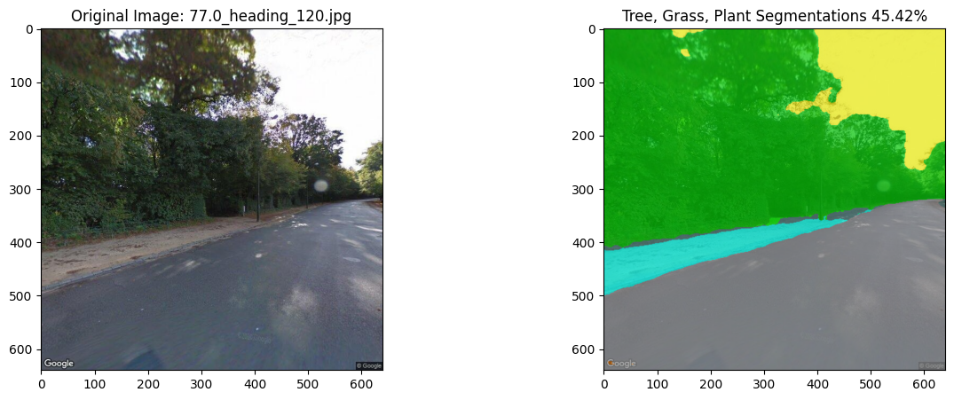
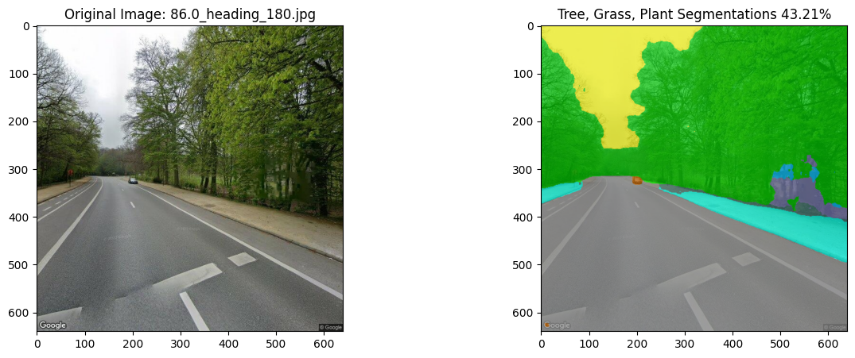
Image Segmentation results
Urban Environment
Green Environment

Slide 21
Individual Case studies
ParticipantID | Height | Weight | BMI | BMI_category | Fitness | Activeness | % Sunny
2 | 160 | 54 | 21.09 | Normal weight | Not Fit | Inactive | 0.56
3 | 183 | 78 | 23.29 | Normal weight | Fit | Active | 20.83
4 | 173 | 99 | 33.08 | Obesity I | Not Fit | Active | 18.11
5 | 191 | 63 | 17.00 | Underweight | Not Fit | Active | 2.84
6 | 170 | 64 | 22.15 | Normal weight | Fit | Inactive | 2.78
7 | 183 | 100 | 29.86 | Overweight | Not Fit | Inactive | 4.42
8 | 165 | 55 | 20.45 | Normal weight | Not Fit | Active | 2.31
9 | 165 | 76 | 24.24 | Normal weight | Fit | Active | 3.23
10 | 183 | 84 | 25.08 | Overweight | Not Fit | Inactive | 18.1
11 | 183 | 72 | 21.50 | Normal weight | Fit | Inactive | 20.83
12 | 182 | 92 | 27.47 | Overweight | Not Fit | Inactive | 16.81
13 | 189 | 75 | 21.00 | Normal weight | Not Fit | Active | 6.78
14 | 179 | 70 | 21.85 | Normal weight | Fit | Active | 0.77
15 | 181 | 78 | 23.81 | Normal weight | Fit | Active | 18.03
16 | 174 | 63 | 20.81 | Normal weight | Fit | Inactive | 21.37
17 | 177 | 69 | 22.02 | Normal weight | Fit | Inactive | 3.39
18 | 173 | 83 | 27.73 | Overweight | Not Fit | Inactive | 1.8
Active is when they walk > 30 minutes everyday
Fit is based on BMI – Height/Weight squared
Group 1: P11 vs P16 – Normal weight, Fit but inactive
Group 2: P10 vs P12 – Overweight, not fit and not active
Group 3: P9 vs P17 – Both Normal weight, fit, but active vs inactive
Group 4: P5 vs P7 – Informed Grouping, underweight vs overweight

Slide 22
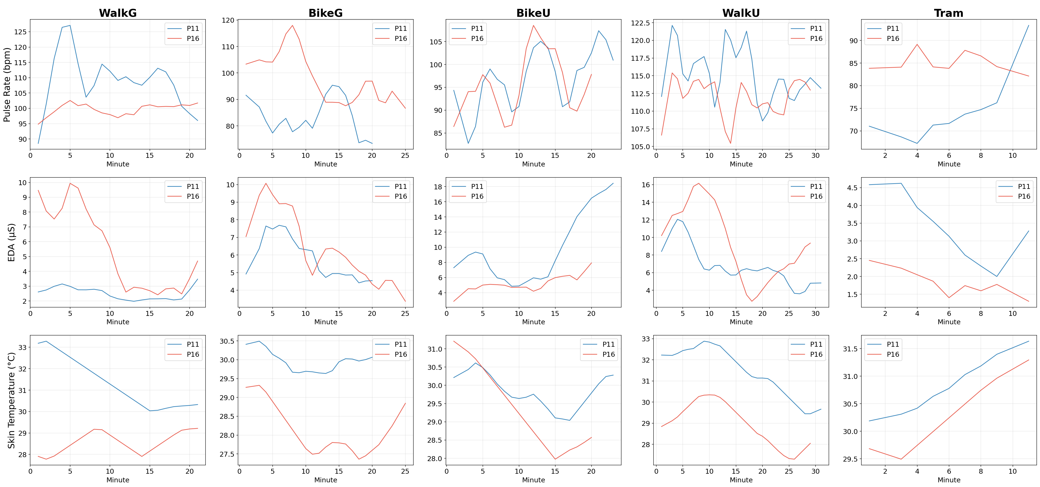
Group 1
P11 [Fit, Inactive] (183 cm, 72 kg) vs P16 [Fit, Inactive] (174 cm, 63 kg)
P11 taller; P11 heavier. EDA: higher for P11 in BikeU, Tram; P16 in BikeG, WalkG, WalkU.
Skin Temp: higher for P11 in BikeG, WalkG, WalkU, BikeU; P16 in Tram.
Sunny threshold used for Clearness Index: Kt >= 0.65. Very light grey shading marks mean Kt < 0.65.

Slide 23
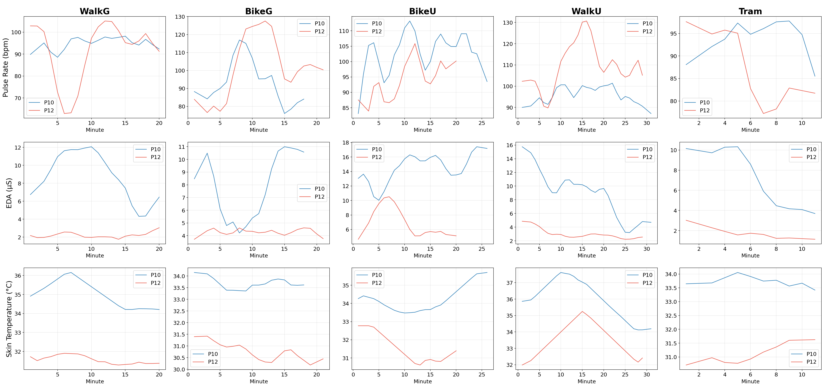
Group 2
P10 [Not Fit, Inactive] (183 cm, 84 kg) vs P12 [Not Fit, Inactive] (183 cm, 92 kg)
Similar height; P12 heavier. EDA: higher for P10 in all phases.
Skin Temp: higher for P10 in all phases.
Sunny threshold used for Clearness Index: Kt >= 0.65. Very light grey shading marks mean Kt < 0.65.

Slide 24
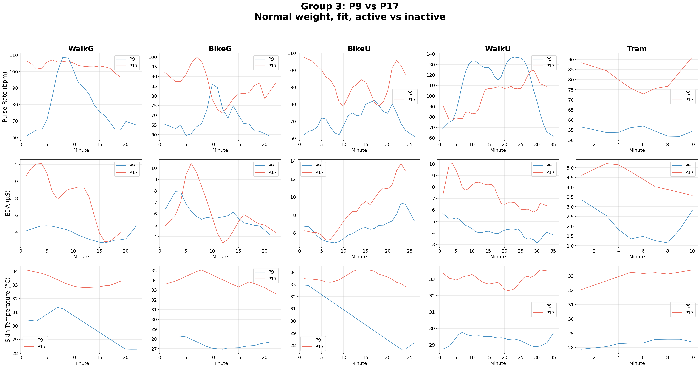
Group 3
P9 [Fit, Active] (165 cm, 66 kg) vs P17 [Fit, Inactive] (177 cm, 69 kg)
P17 taller; P17 heavier. EDA: higher for P17 in all phases.
Skin Temp: higher for P17 in all phases.
Sunny threshold used for Clearness Index: Kt >= 0.65. Very light grey shading marks mean Kt < 0.65.

Slide 25
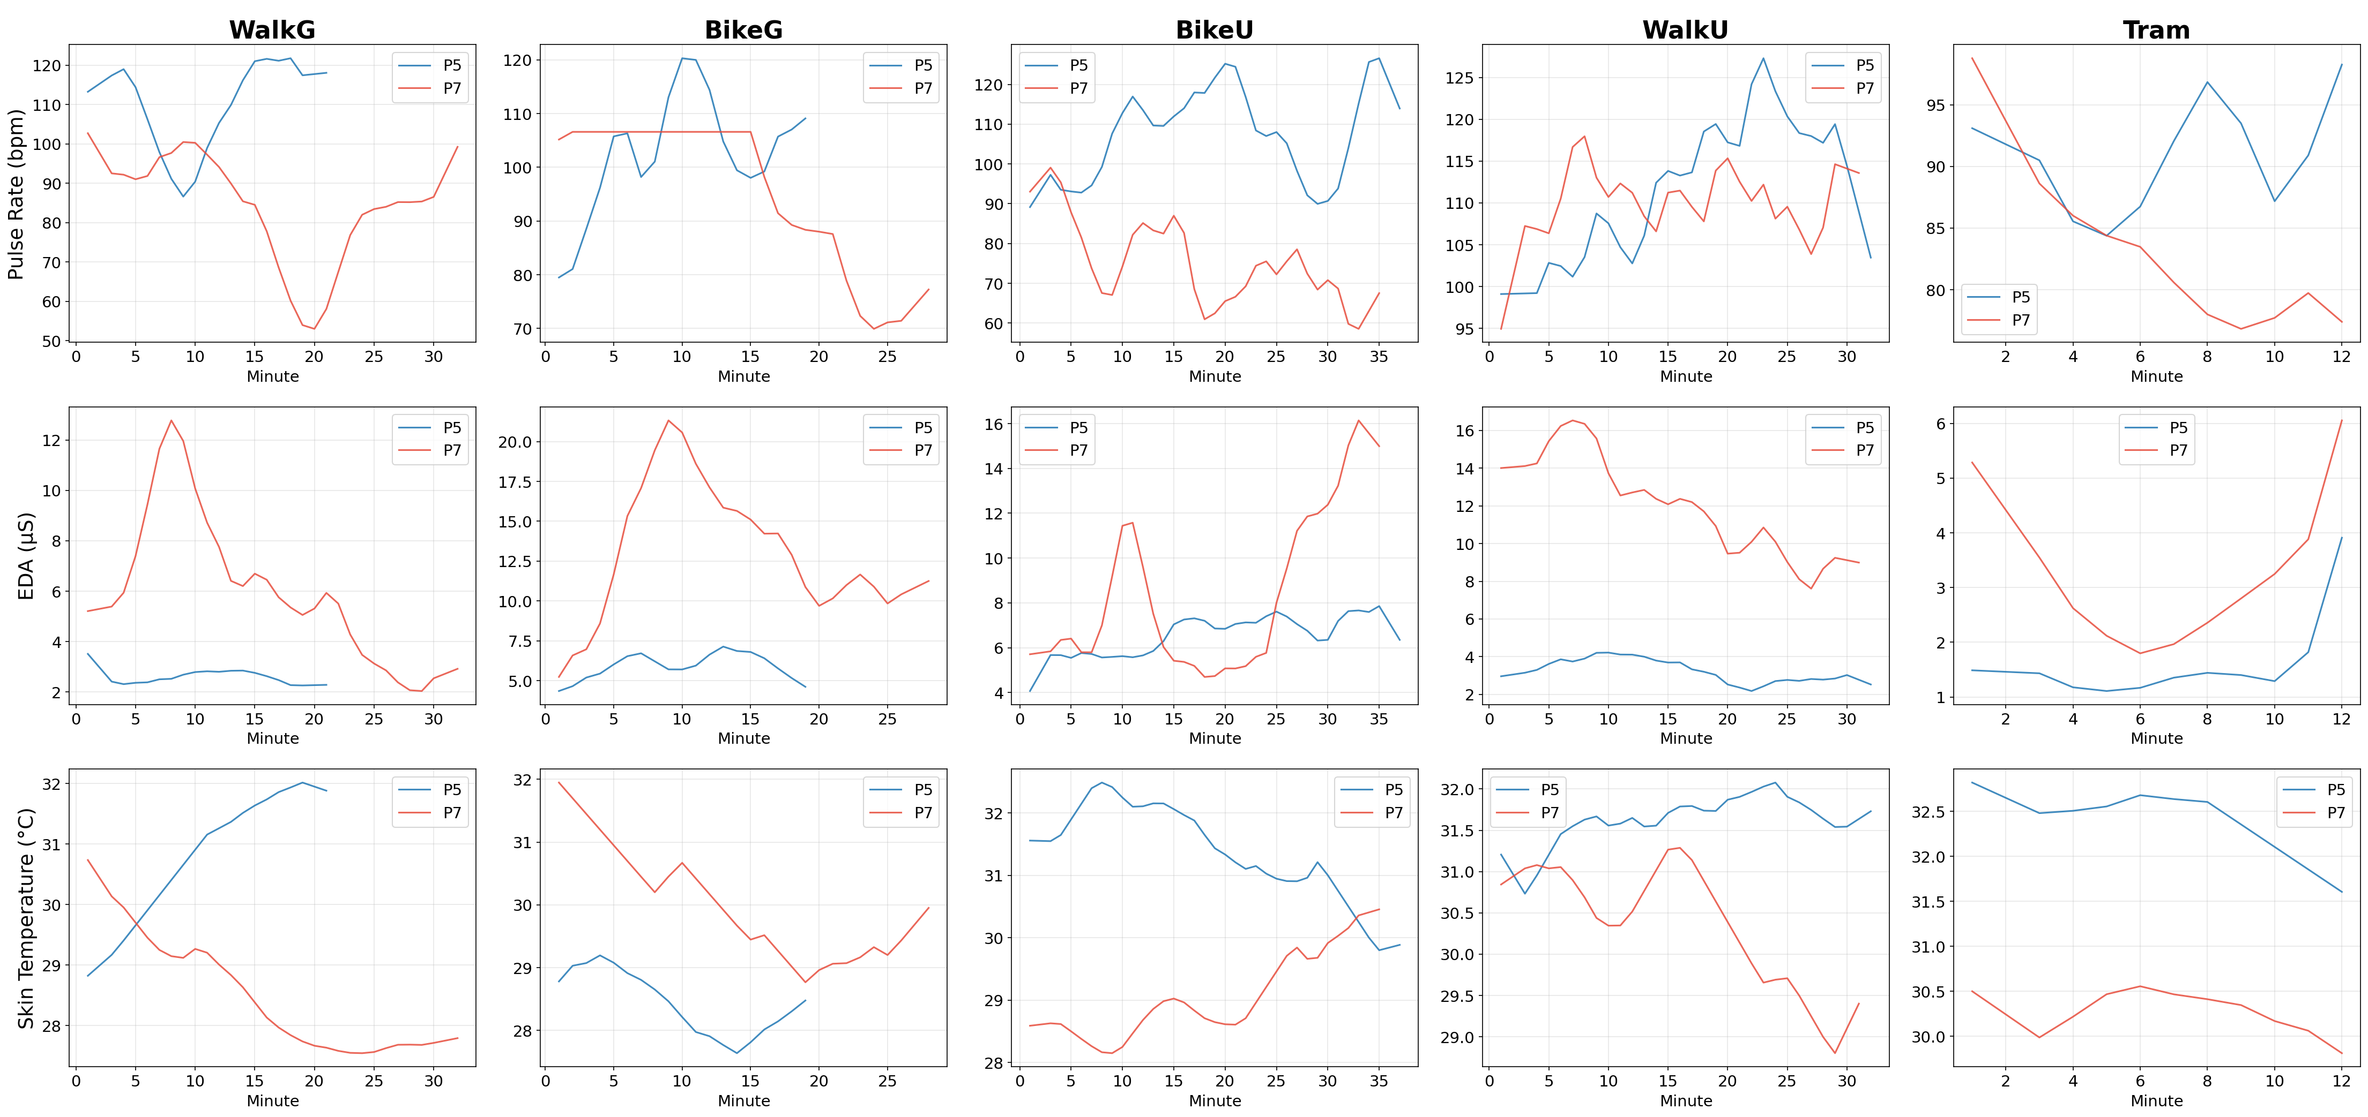
Group 4
P5 [Not Fit, Active] (191 cm, 62 kg) vs P7 [Not Fit, Inactive] (183 cm, 100 kg)
P5 taller; P7 heavier. EDA: higher for P7 in all phases.
Skin Temp: higher for P5 in WalkG, WalkU, BikeU, Tram; P7 in BikeG.
Sunny threshold used for Clearness Index: Kt >= 0.65. Very light grey shading marks mean Kt < 0.65.

